Slide 1
Extract characteristic module values from PAN File
Use fit_cec_sam function to generate the input parameters
Use calcparams_cec/desoto function to generate the single diode model input parameters
Use singlediode function to calculate string DC power
Extract characteristic module values from PAN File
Calculate photocurrent & diode reverse saturation current @ STC
Use calcparams_PVSyst function to generate the single diode model input parameters
Use singlediode function to calculate string DC power
CEC/Desoto
Import matrix of 61853 test data
Use fit_efficiency_model to generate optimized values
Use model function to calculate efficiency
Convert normalized efficiency to DC power
PVSyst
Matrix Models

Slide 2
Model | Sandia Array Performance Model (SAPM) | PVWatts | Single Diode Models (CEC, Desoto, PVSyst) | Matrix Models (ADR, Heydenreich, MotherPV, PVGIS, MPM5, MPM6, Bilinear)
Input Parameters
Effective Irradiance | ✔ | ✔ | ✔ | ✔
Cell Temperature | ✔ | ✔ | ✔
Module Temperature |  |  |  | ✔
SAPM Coefficients | ✔
STC Power & Temperature Coefficient |  | ✔
PAN File Coefficients |  |  | ✔
61853 Matrix Data |  |  |  | ✔
Output Values
Isc | ✔ |  | ✔
Imp | ✔ |  | ✔
Vmp | ✔ |  | ✔
Voc | ✔ |  | ✔
Pmp | ✔ | ✔ | ✔
Efficiency |  |  |  | ✔

Slide 3
Manufacturer & Model | Cell Technology | # of Modules | Installation Date
LG 320N1K-A5 | N-PERT Si | 4 strings of 12 (48) | June 2018
Panasonic VBHN325SA16 | HIT Mono | 4 strings of 12 (48) | June 2018
Canadian Solar CS6K-270P | Poly-Si | 4 strings of 12 (48) | October 2017
Canadian Solar CS6K-275M | Mono-Si | 4 strings of 12 (48) | October 2017
Hanwha Q Cells Plus Q.Plus BFR-G4.1 280 | Poly-Si PERC | 4 strings of 12 (48) | October 2017
Hanwha Q Cells Peak Q.Peak BFR-G4.1 290 | Mono-Si PERC | 4 strings of 12 (48) | October 2017
Mission Solar MSE300SQ5T | Mono-Si PERC | 4 strings of 12 (48) | May 2019
Jinko Solar JKM260P-60 | Poly-Si | 4 strings of 12 (48) | April 2020*
Itek Energy IT-360-SE72 | Mono-Si PERC | 5 strings of 10 (50) | March 2020
*The Jinko system was initially installed in June 2016 but was later moved to the current configuration at the given date

Slide 4
Filter Parameter | Lower Bound | Upper Bound
Solar Elevation | 15 deg | 90 deg
Effective Irradiance | 50 W/m² | 1200 W/m²
Cell Temperature | -40 C | 85 C
Module Temperature | -40 C | 85 C
Ambient Temperature | -10 C | 40 C

Slide 5
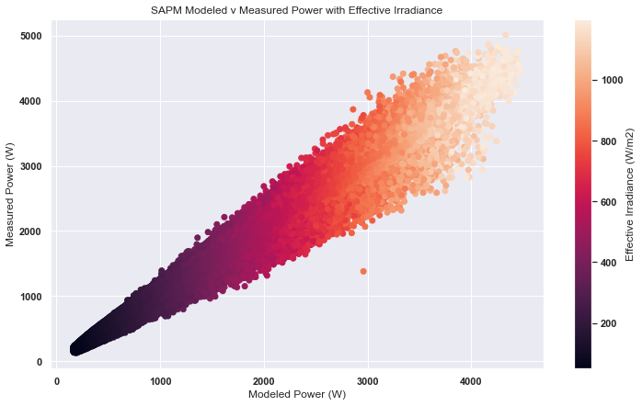
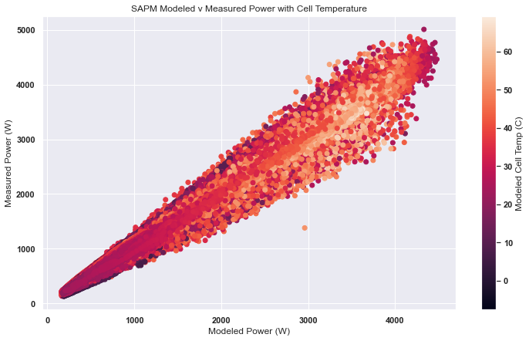
Notes:
Modeled vs Measured power for SAPM model for LG System with temperature & irradiance as color

Slide 6
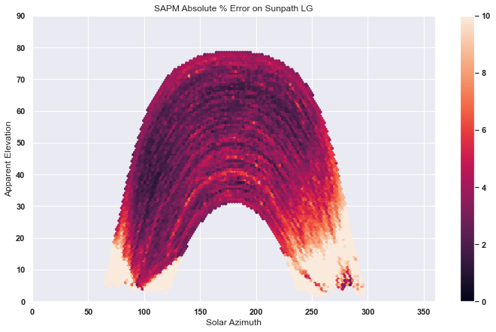
Notes:
SAPM mean absolute percent error on sunpath as color for LG System

Slide 7
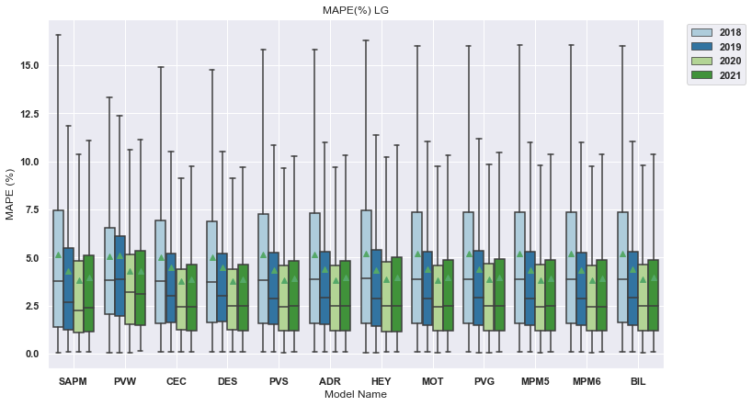
Notes:
MAPE for individual LG System, can also be displayed as years on x and models as hue

Slide 8
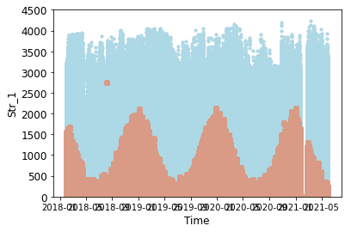
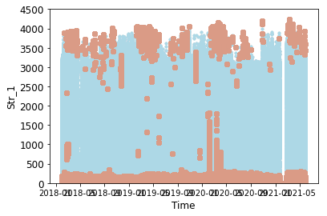
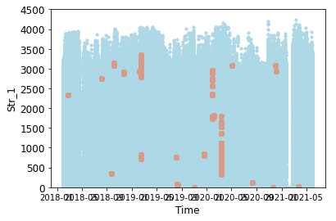
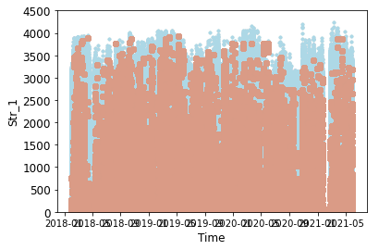
Can275 – All Years
Bounds used for filtering meteo data for PVPMC Intercomparison
Sol. Elev 15<x<90 – 60.62%
Eff Irr 50<x<1200 – 56.23%
Cell Temp -40<x<85 – 0.008%
Ratio of IvsG 0.004<x<0.008 – 56.48%
Total % Filtered for all years: 63.79%
Notes:
Visualization of filters used on data for Can 275 system, can also be represented as the filter on top of the physical parameter itself (instead of on power like above)

Slide 9
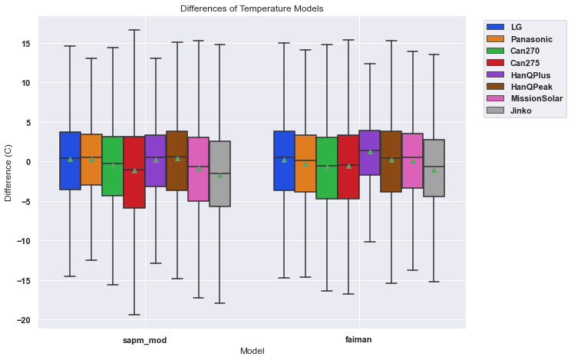

Slide 10
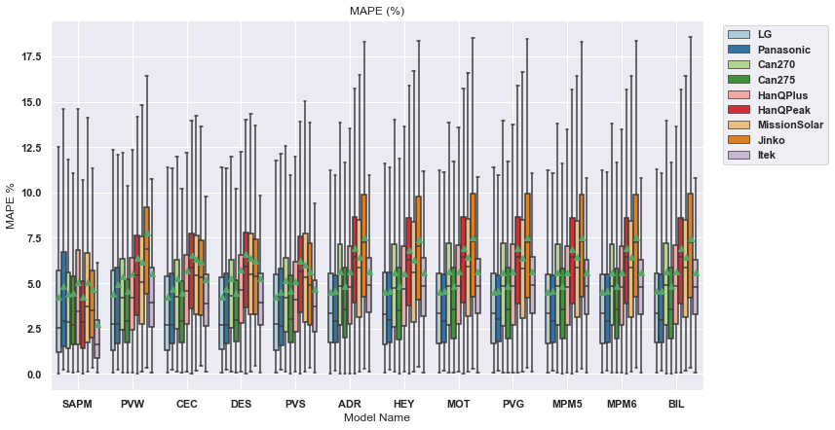

Slide 11
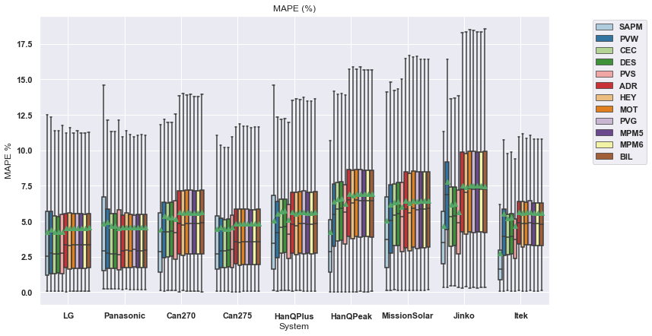

Slide 12
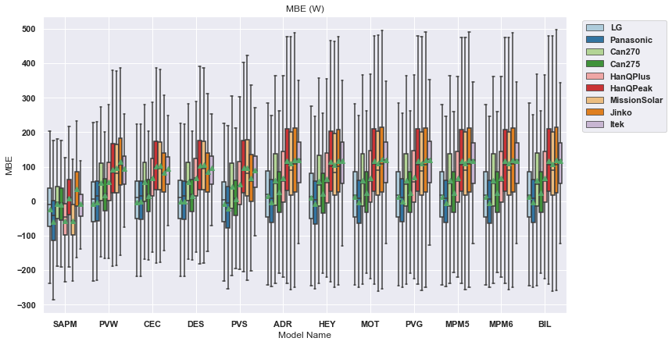
Notes:
MBE for all systems & all models & all years, can also be displayed with models on x axis and systems as hue (next slide)

Slide 13
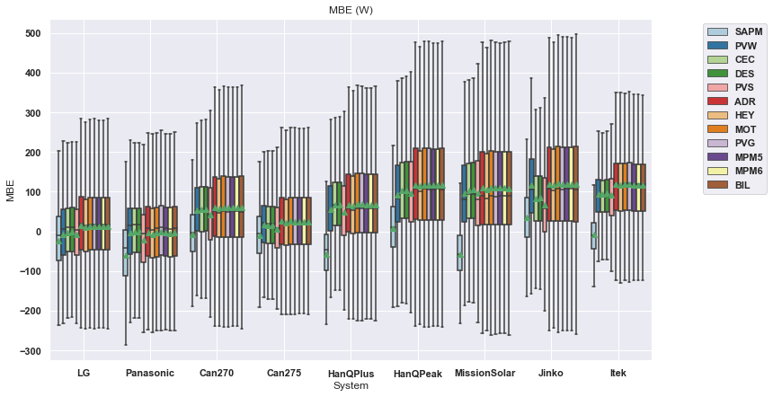

Slide 14
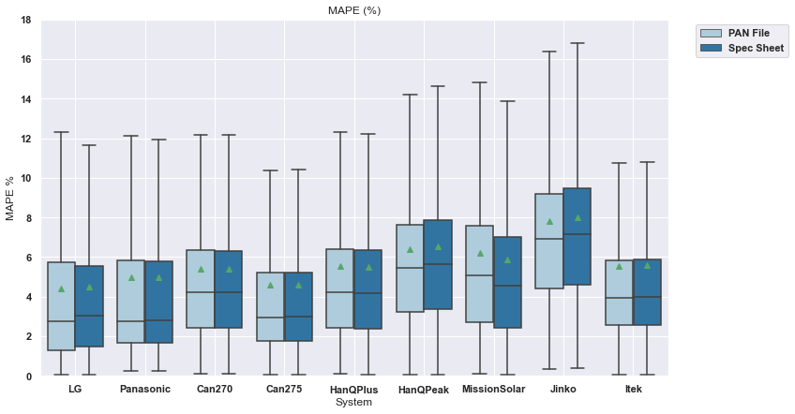
PVWatts

Slide 15
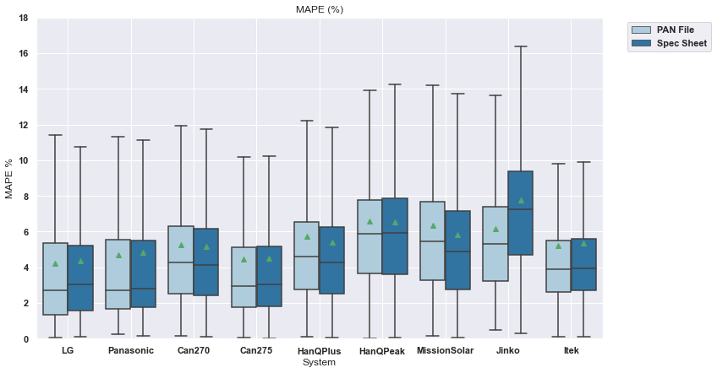
CEC

Slide 16
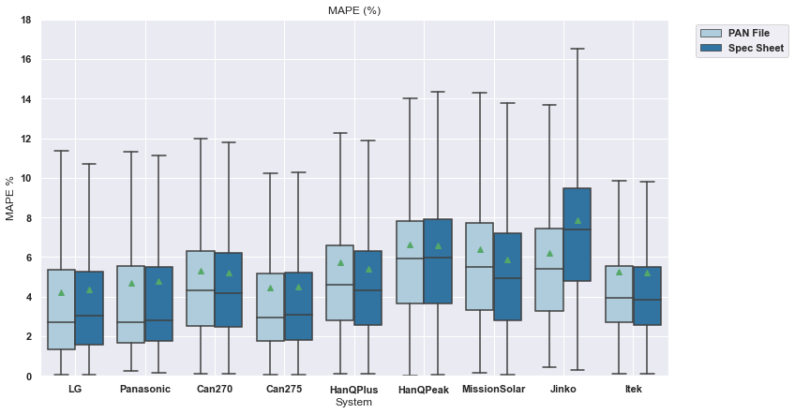
Desoto

Slide 17
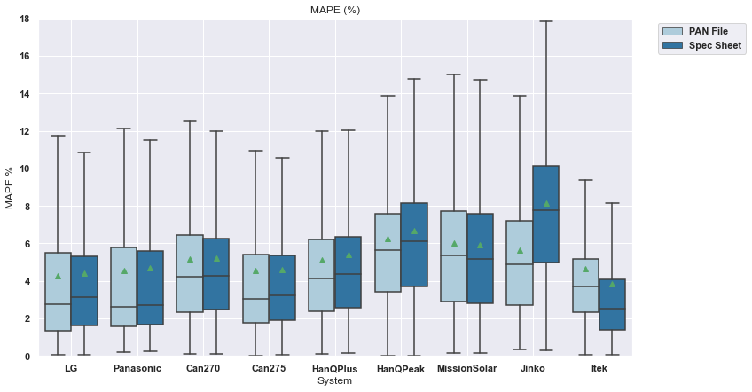
PVSyst

